Slide 1
Videos & Unsupervised Learning
Donghwa KIM

Slide 2
Contents
Video
Dense trajectories and motion boundary descriptors
Spatio-Temporal ConvNet
Long-time Spatio – Temporal ConvNets

Slide 3
Contents
Video
Dense trajectories and motion boundary descriptors
Spatio-Temporal ConvNet
Long-time Spatio – Temporal ConvNets

Slide 4
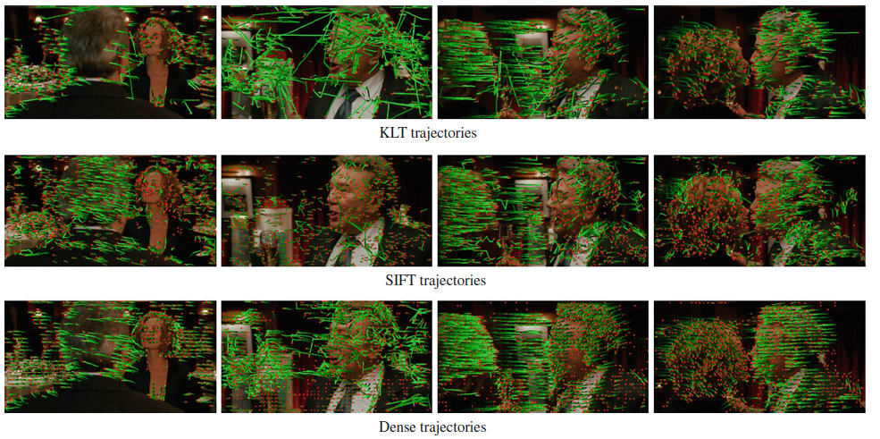
Dense trajectories and motion boundary descriptors
Video learning procedure
Detecting key points in that video
Tracking them
All these are tracked across video
Surrounding features in video
Wang, H., Kläser, A., Schmid, C., & Liu, C.-L. (2013). Dense trajectories and motion boundary descriptors for action recognition. International Journal of Computer Vision, 103(1), 60-79.
Notes:
Trajectories capture the local motion information of the video
From optical flow

Slide 5
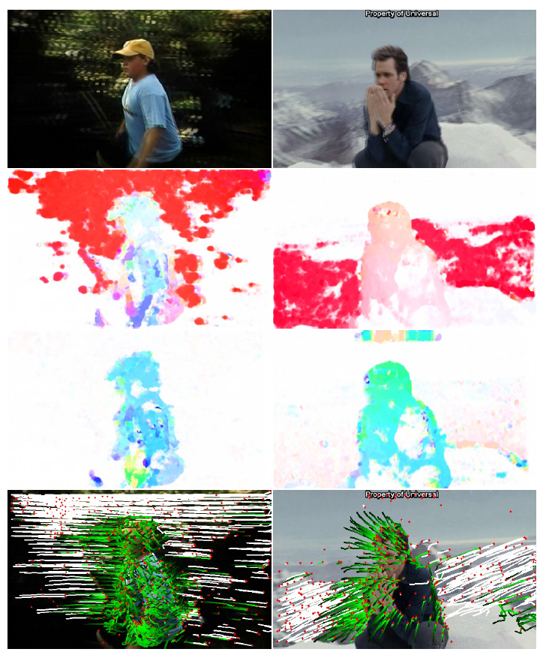
Dense trajectories and motion boundary descriptors
Images of two consecutive frames overlaid
Optical ﬂow between the two frames
Optical ﬂow after removing camera motion
Trajectories removed due to camera motion in white
Wang, H., & Schmid, C. (2013). Action recognition with improved trajectories. Paper presented at the Proceedings of the IEEE International Conference on Computer Vision.
Notes:
카메라 모션 : 움직임은 매우 작다고 가정
두 프레임간의 대응성,
extracting SURF feature(robust bluring) and match them based on Nearest Neighor
Motion vector from optical frame polynomial expansion

Slide 6
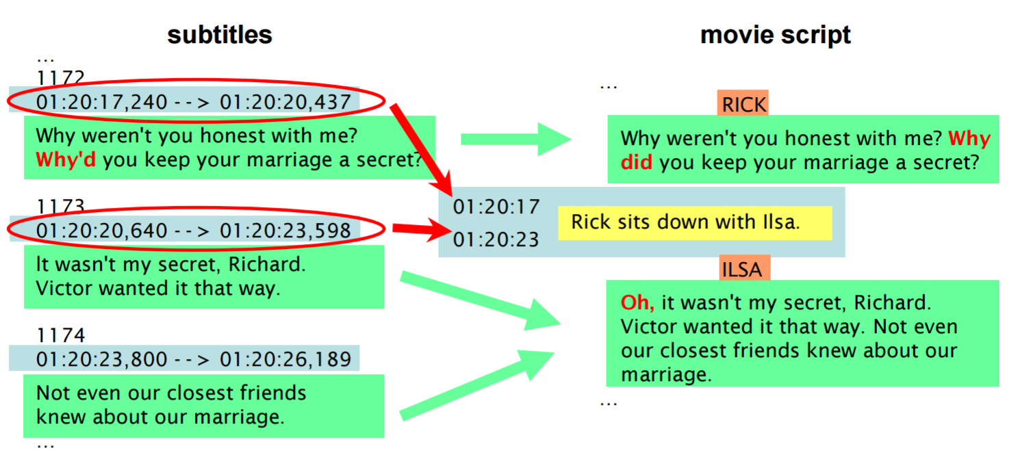
Dense trajectories and motion boundary descriptors
An example

Slide 7
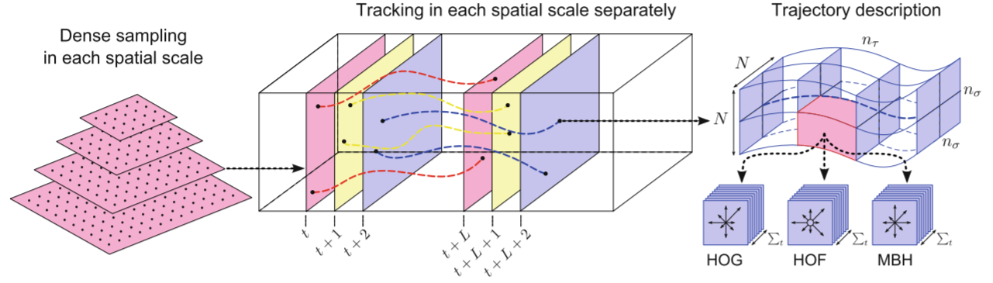
Dense trajectories and motion boundary descriptors
Detect feature points in different scale
Track features with optical flow (movement)
Extract a whole bunch of features
Local coordinate system of every single tracklet
HOG(Histogram of Gradients)
HOF(Histogram of Flow)
MBH (Motion boundary histogram)-state of art
Wang, H., Kläser, A., Schmid, C., & Liu, C.-L. (2013). Dense trajectories and motion boundary descriptors for action recognition. International Journal of Computer Vision, 103(1), 60-79.
Notes:
1. Optical flow : how to move one frame to another
2. we remove trajectories consistent with it from optical flow
3. 특징을 추출할 수 있음
Characterize shape : point coordinate
Appearance :histograms of oriented gradients
Motion : histograms of oprical flow

Slide 8
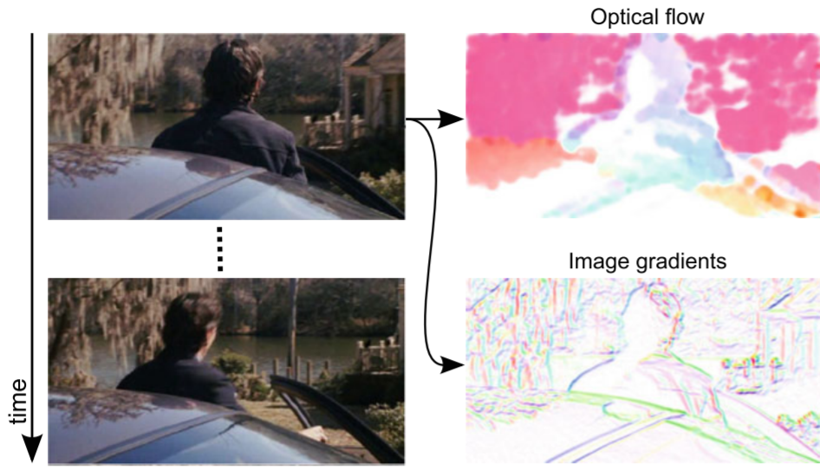
Dense trajectories and motion boundary descriptors
Optical flow algorithms
Take a frame and a second frame
Solve for a motion field of displacement vector at every single position
Colored by a direction in which that part of the image is currently moving in the video
Encourage you to use large displacement optical flow
End up tracking, roughly 15 frames at a time
We end up with these half a second roughly tracklet
(Farnebäck, 2003; Brox & Malik, 2011; Wang, Kläser, Schmid, & Liu, 2013)

Slide 9
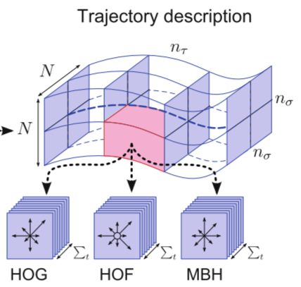
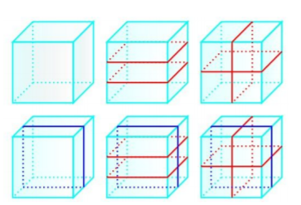
Dense trajectories and motion boundary descriptors
Trajectory description
Encode regions around this tracklet with all these descriptors
Tracklet : 15frames, (X, Y positions) (on the left panel)
Accumulate all these visual features in the histograms
CNN (on the right panel)
We extract features in the local coordinate system
Wang, H., Kläser, A., Schmid, C., & Liu, C.-L. (2013). Dense trajectories and motion boundary descriptors for action recognition. International Journal of Computer Vision, 103(1), 60-79.
Notes:
Independent histogram
Every one of these bins
It is going to basically create all these histograms per bin with all these visual features
All of this then goes into an SVM

Slide 10

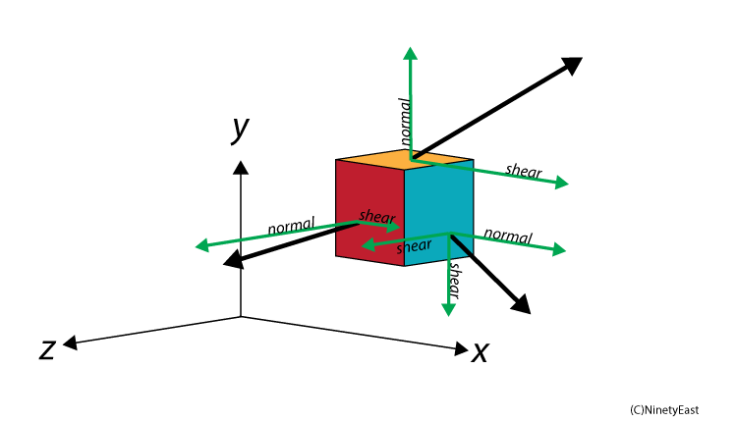
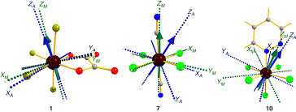
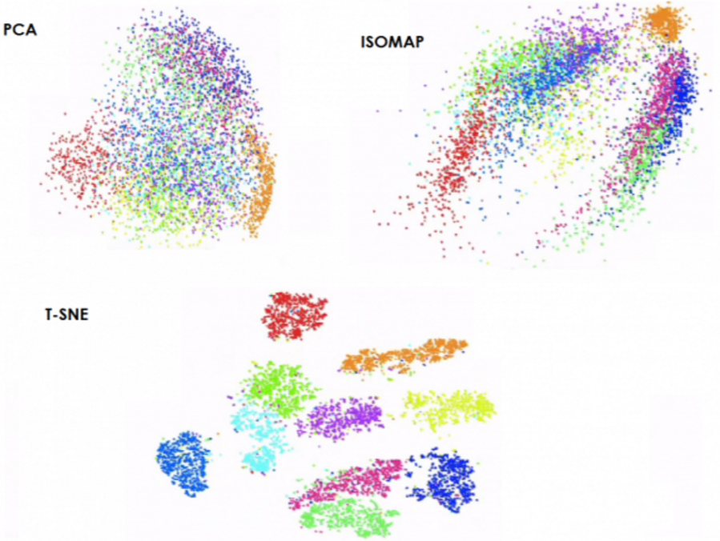
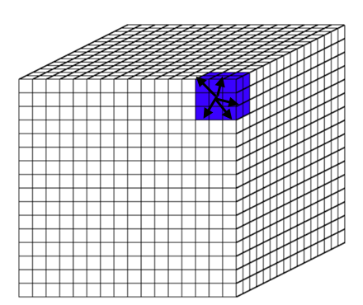
The framework of dense trajectories
basic formula
2- dimensional vector field per frame
Magnitude is quantized in o orientations
Aggregate these responses over blocks of pixels
Descriptors have to be normalized such as PCA
Concatenate responses of several adjacent pixel blocks
Aggregate these responses over blocks of pixels in s in both spatial and temporal directions

Slide 11

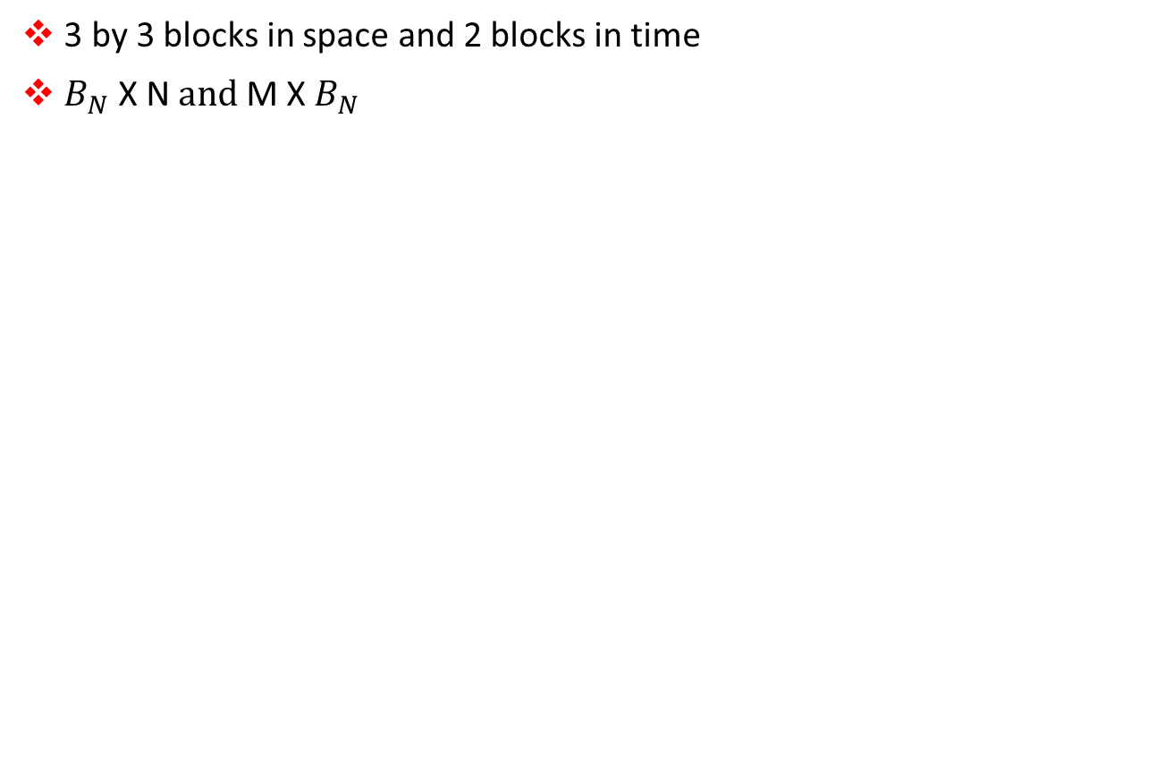
The framework of dense trajectories
3 by 3 blocks in space and 2 blocks in time
$B_{N}$ X N $and \text{M}$ X${ B}_{N}$
Block : 3x3x2
height
time
width

Slide 12
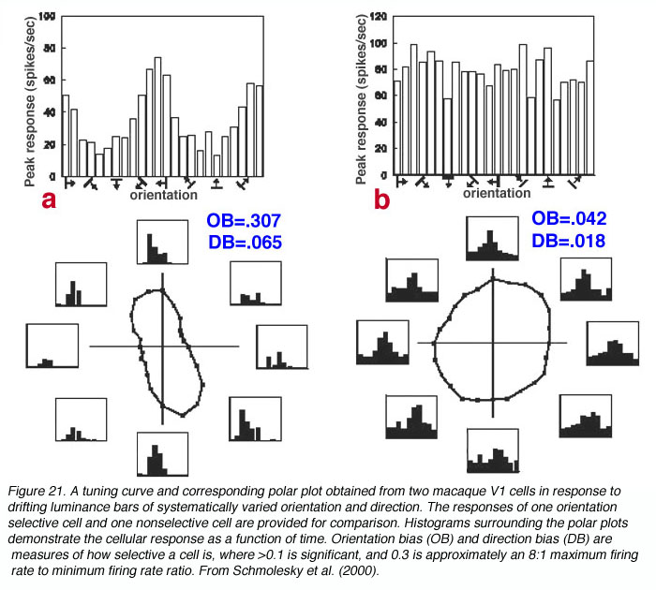
The framework of dense trajectories
Orientation

Slide 13
The framework of dense trajectories
Trajectory
Dense
sampling
Dense
sampling
Trajectory shape descriptor
Dense
sampling
point coordinate
Dense
sampling
Dense
sampling
Dense
sampling
Dense
sampling
Structure
histograms of oriented gradients
(HOG, SIFT)
Motion
histograms of optical flow
(HOF, MBH)

Slide 14
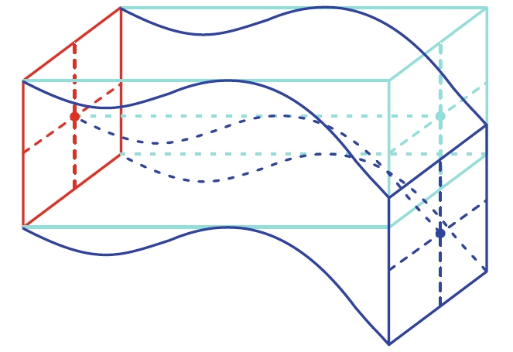
The framework of dense trajectories
Descriptor : HOG, HOF and MBH
HOG : Gradient magnitude responses in horizontal and vertical directions.
HOF : Optical flow displacement vectors in horizontal and vertical directions
MBH: To represent the oriented gradients computed over the vertical and the horizontal optical flow components
gray-level “images” of the motion components
Combined MBHx and MBHy

Slide 15
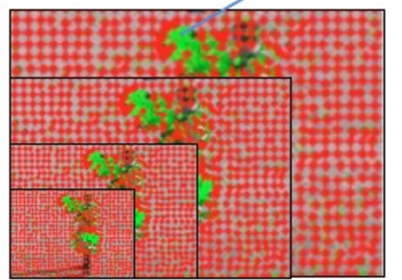
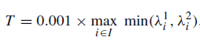
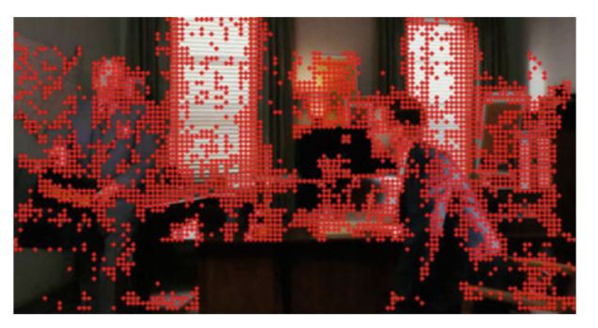
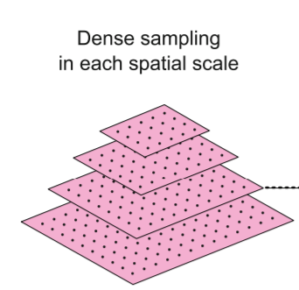
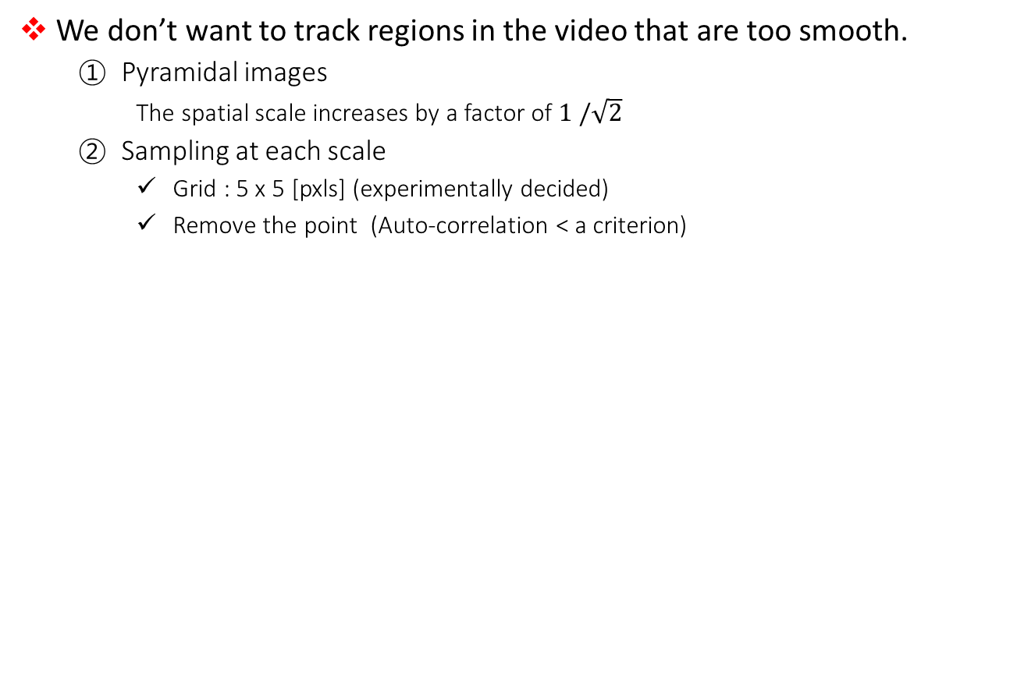
Dense trajectories and motion boundary descriptors
Dense
sampling
We don’t want to track regions in the video that are too smooth.
Pyramidal images
The spatial scale increases by a factor of $1 /\sqrt{2}$
Sampling at each scale
Grid : 5 x 5 [pxls] (experimentally decided)
Remove the point (Auto-correlation < a criterion)
8 spatial scale
Shi, J. (1994). Good features to track. Paper presented at the Computer Vision and Pattern Recognition, 1994. Proceedings CVPR'94., 1994 IEEE Computer Society Conference on.
Notes:
비디오 안에서 샘플링된 포인트들을 추적하고 싶음
동일한 프레임안에서 궤도를 추적하기 어려움 이를 제거하는 컷오프가 T
오토 코릴레이션이 작으면 포인트들이 제거 (기준:
0.001 은 실험적으로 잘노오더라 sailiency
첫번째 스케일

Slide 16
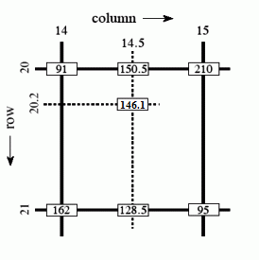
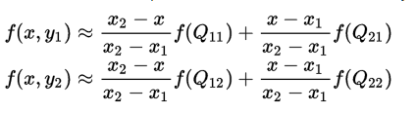
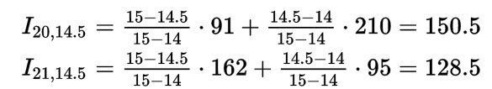
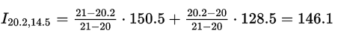
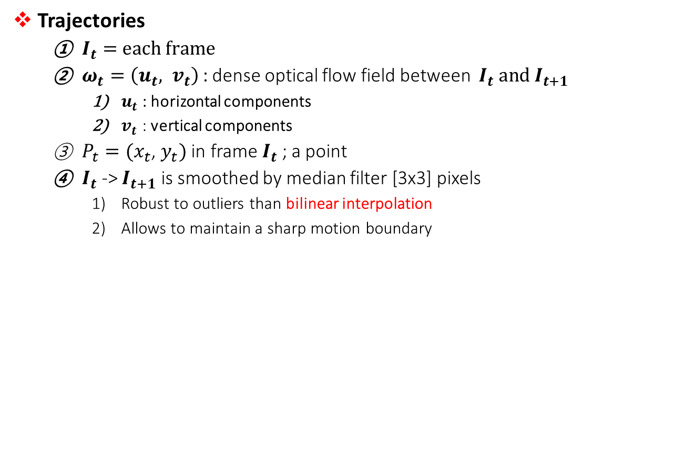
Dense trajectories and motion boundary descriptors
Dense
sampling
Trajectories
$I_{t}=$ $each frame$
$ω_{t}=\left(u_{t}, v_{t}\right)$ : dense optical flow field between $I_{t} and I_{t+1}$
$u_{t}$ : horizontal components
$v_{t}$ : vertical components
$P_{t}=(x_{t}$, $y_{t})$ in frame $I_{t}$ ; a point
$I_{t}$ -> $I_{t+1}$ is smoothed by median filter [3x3] pixels
Robust to outliers than bilinear interpolation
Allows to maintain a sharp motion boundary
Trajectories
https://en.wikipedia.org/wiki/Bilinear_interpolation
Notes:
필드 한번 계산하면 안해도 됨
불규칙한 패턴을 찾아내면서 로버스트해짐
빨간색은 따라가고 파란색은 가만히있어야함

Slide 17
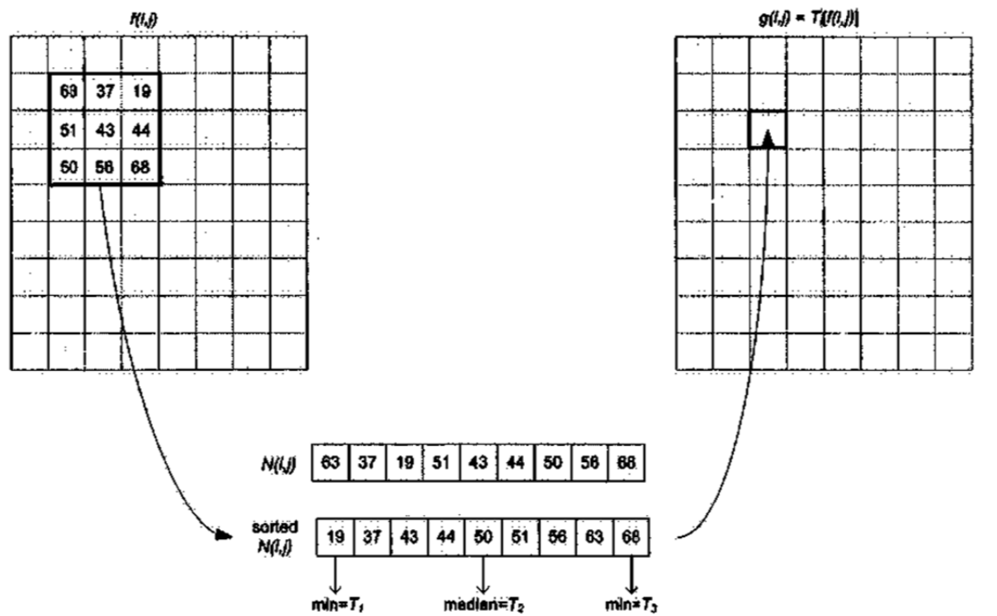
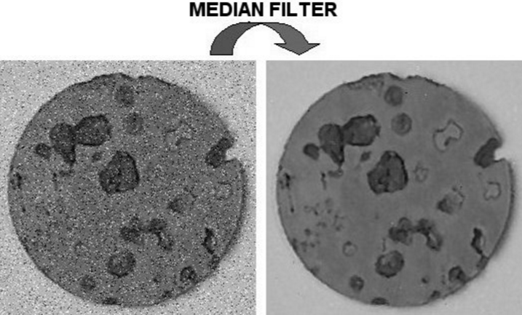
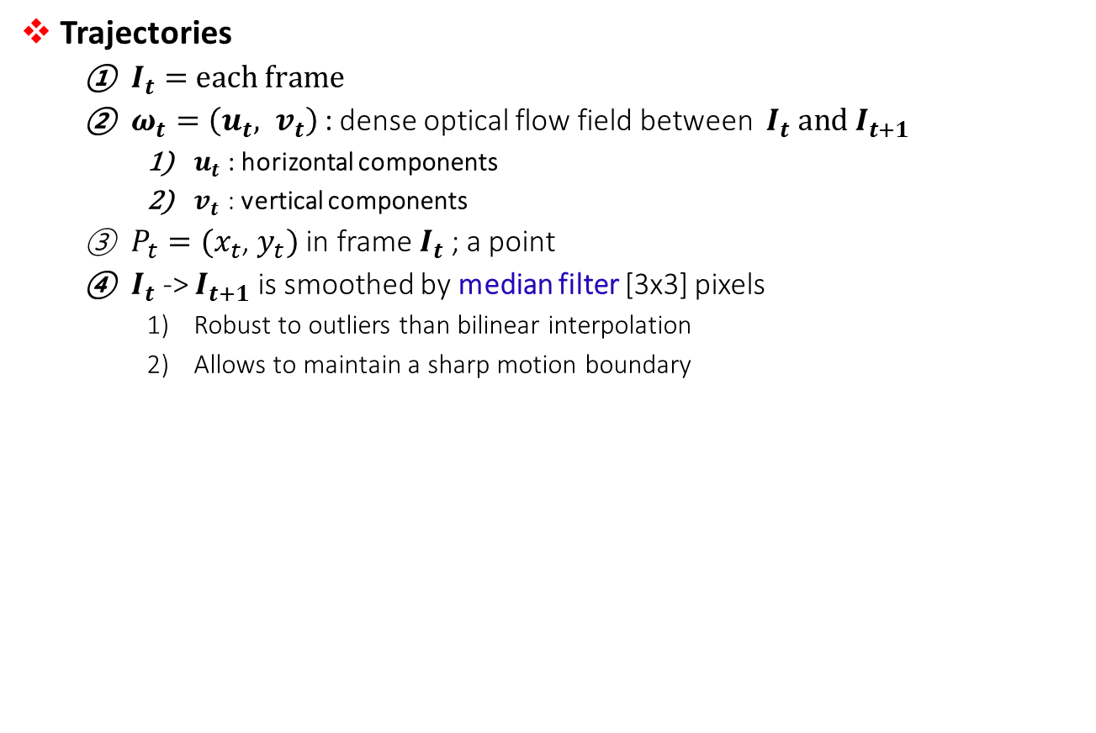
Dense trajectories and motion boundary descriptors
Dense
sampling
Trajectories
$I_{t}=$ $each frame$
$ω_{t}=\left(u_{t}, v_{t}\right)$ : dense optical flow field between $I_{t} and I_{t+1}$
$u_{t}$ : horizontal components
$v_{t}$ : vertical components
$P_{t}=(x_{t}$, $y_{t})$ in frame $I_{t}$ ; a point
$I_{t}$ -> $I_{t+1}$ is smoothed by median filter [3x3] pixels
Robust to outliers than bilinear interpolation
Allows to maintain a sharp motion boundary
Trajectories
http://what-when-how.com/embedded-image-processing-on-the-tms320c6000-dsp/non-linear-filtering-of-images-image-processing-part-1/
Notes:
필드 한번 계산하면 안해도 됨
불규칙한 패턴을 찾아내면서 로버스트해짐
빨간색은 따라가고 파란색은 가만히있어야함

Slide 18
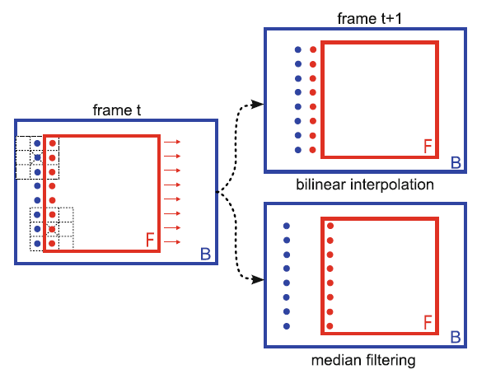
Dense trajectories and motion boundary descriptors
Dense
sampling
Trajectories
$I_{t}=$ $each frame$
$ω_{t}=\left(u_{t}, v_{t}\right)$ : dense optical flow field between $I_{t} and I_{t+1}$
$u_{t}$ : horizontal components
$v_{t}$ : vertical components
$P_{t}=(x_{t}$, $y_{t})$ in frame $I_{t}$ ; a point
$I_{t}$ -> $I_{t+1}$ is smoothed by median filter [3x3] pixels
Robust to outliers than bilinear interpolation
Allows to maintain a sharp motion boundary
Trajectories
Kernel
Notes:
필드 한번 계산하면 안해도 됨
불규칙한 패턴을 찾아내면서 로버스트해짐
빨간색은 따라가고 파란색은 가만히있어야함

Slide 19
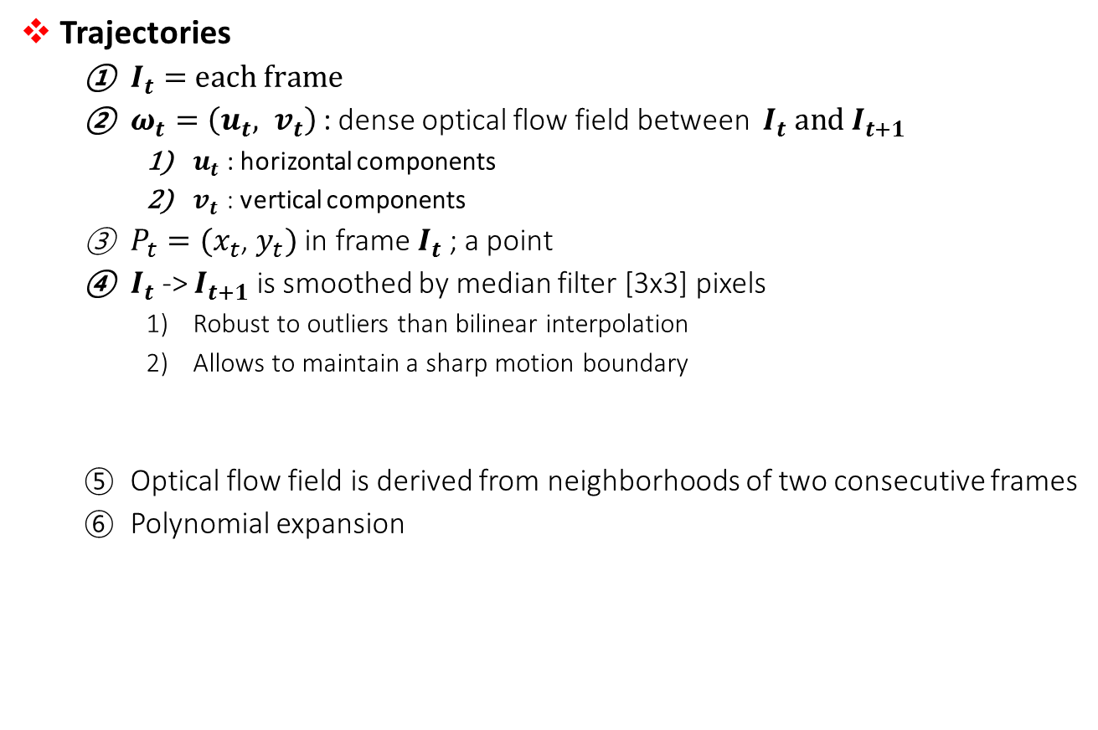
Dense trajectories and motion boundary descriptors
Dense
sampling
Trajectories
$I_{t}=$ $each frame$
$ω_{t}=\left(u_{t}, v_{t}\right)$ : dense optical flow field between $I_{t} and I_{t+1}$
$u_{t}$ : horizontal components
$v_{t}$ : vertical components
$P_{t}=(x_{t}$, $y_{t})$ in frame $I_{t}$ ; a point
$I_{t}$ -> $I_{t+1}$ is smoothed by median filter [3x3] pixels
Robust to outliers than bilinear interpolation
Allows to maintain a sharp motion boundary
Optical flow field is derived from neighborhoods of two consecutive frames
Polynomial expansion
Trajectories
Notes:
필드 한번 계산하면 안해도 됨
불규칙한 패턴을 찾아내면서 로버스트해짐

Slide 20
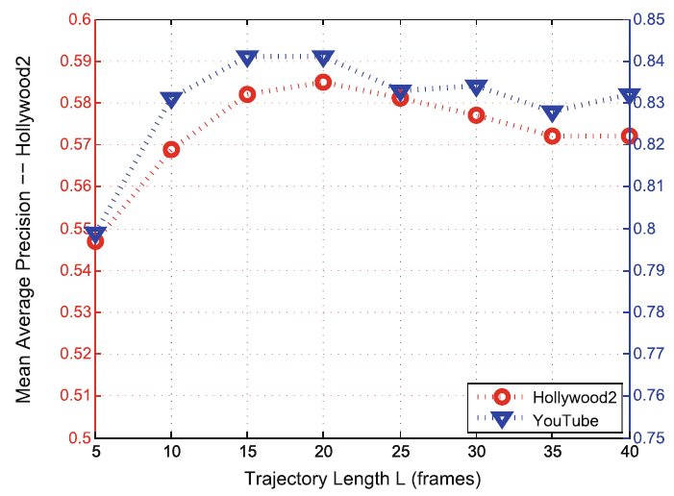
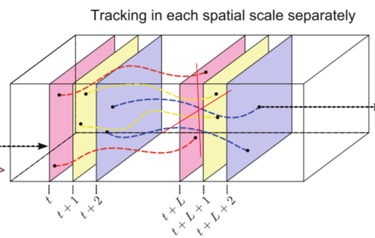
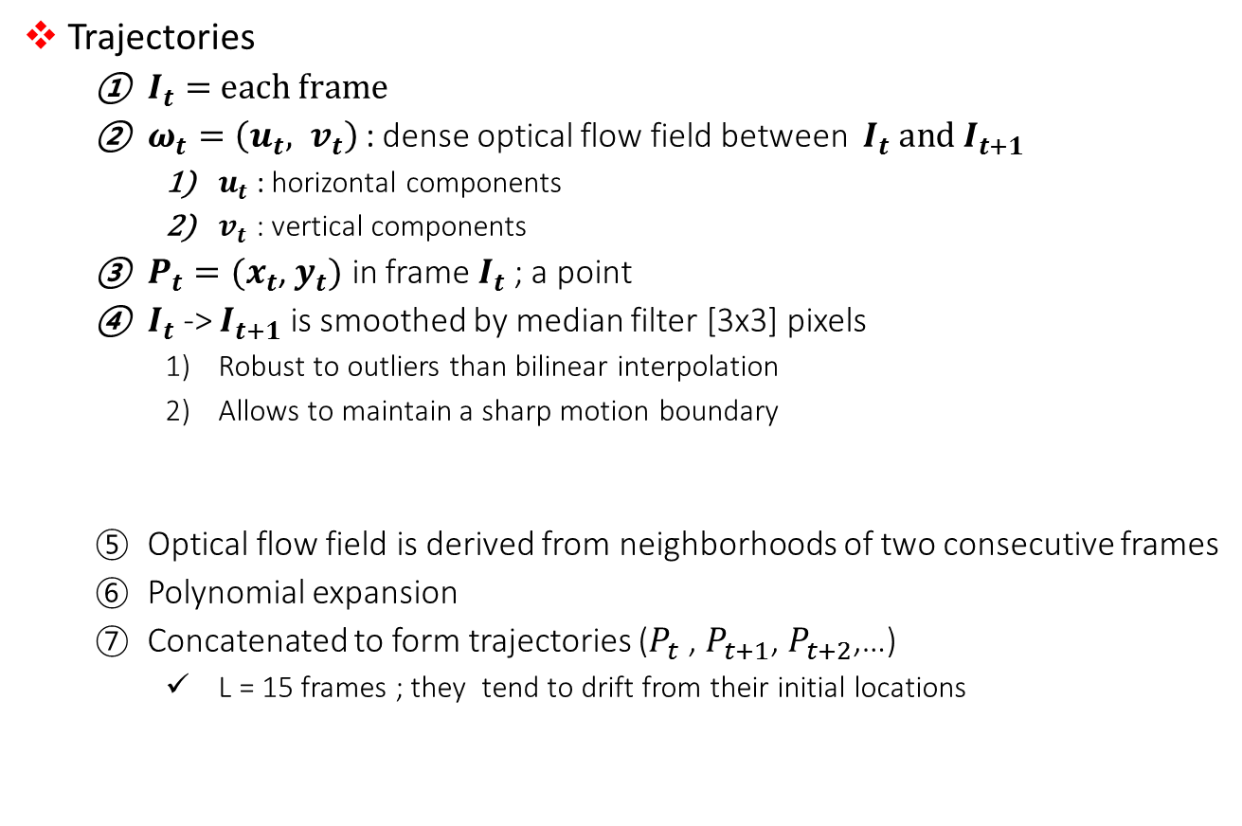
Dense trajectories and motion boundary descriptors
Dense
sampling
Trajectories
$I_{t}=$ $each frame$
$ω_{t}=\left(u_{t}, v_{t}\right)$ : dense optical flow field between $I_{t} and I_{t+1}$
$u_{t}$ : horizontal components
$v_{t}$ : vertical components
$P_{t}=(x_{t}$, $y_{t})$ in frame $I_{t}$ ; a point
$I_{t}$ -> $I_{t+1}$ is smoothed by median filter [3x3] pixels
Robust to outliers than bilinear interpolation
Allows to maintain a sharp motion boundary
Optical flow field is derived from neighborhoods of two consecutive frames
Polynomial expansion
Concatenated to form trajectories ($P_{t}$ , $P_{t+1}$, $P_{t+2}$,…)
L = 15 frames ; they tend to drift from their initial locations
Trajectories
Notes:
필드 한번 계산하면 안해도 됨
불규칙한 패턴을 찾아내면서 로버스트해짐

Slide 21
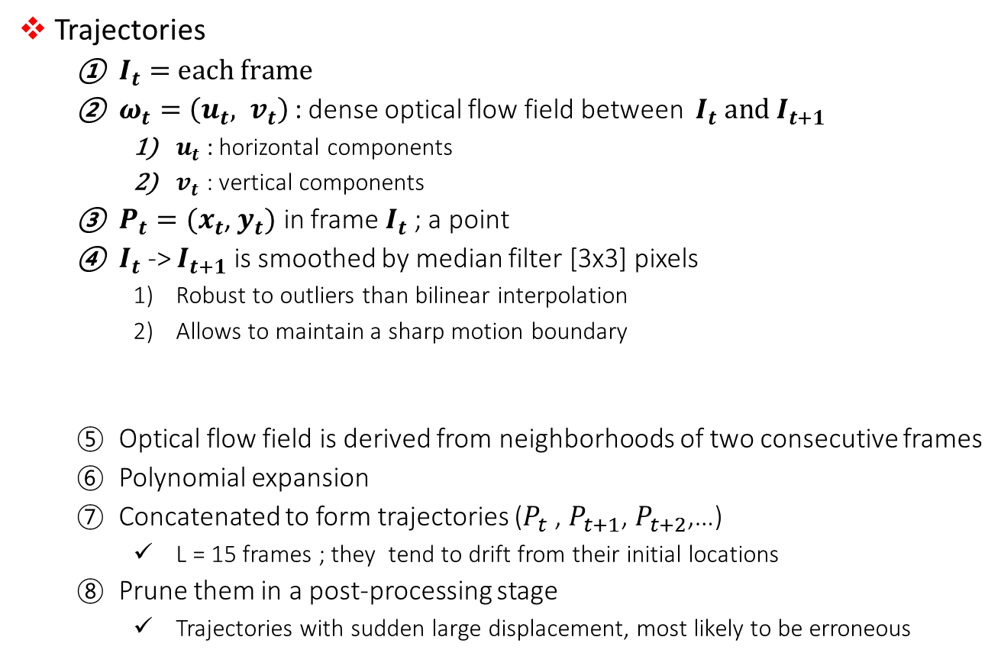
Dense trajectories and motion boundary descriptors
Dense
sampling
Trajectories
$I_{t}=$ $each frame$
$ω_{t}=\left(u_{t}, v_{t}\right)$ : dense optical flow field between $I_{t} and I_{t+1}$
$u_{t}$ : horizontal components
$v_{t}$ : vertical components
$P_{t}=(x_{t}$, $y_{t})$ in frame $I_{t}$ ; a point
$I_{t}$ -> $I_{t+1}$ is smoothed by median filter [3x3] pixels
Robust to outliers than bilinear interpolation
Allows to maintain a sharp motion boundary
Optical flow field is derived from neighborhoods of two consecutive frames
Polynomial expansion
Concatenated to form trajectories ($P_{t}$ , $P_{t+1}$, $P_{t+2}$,…)
L = 15 frames ; they tend to drift from their initial locations
Prune them in a post-processing stage
Trajectories with sudden large displacement, most likely to be erroneous
Trajectories
Notes:
필드 한번 계산하면 안해도 됨
불규칙한 패턴을 찾아내면서 로버스트해짐

Slide 22
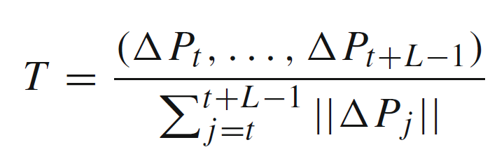
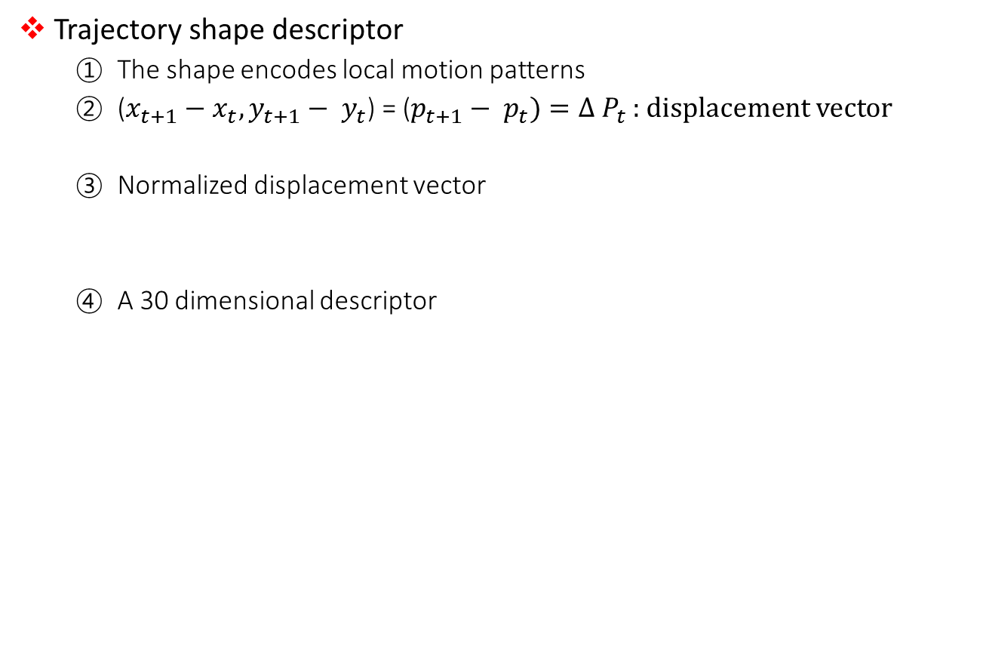
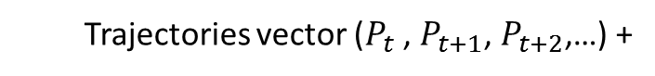
Dense trajectories and motion boundary descriptors
Dense
sampling
Trajectory shape descriptor
The shape encodes local motion patterns
($x_{t+1}−x_{t}, y_{t+1}− y_{t}$) = ($p_{t+1}− p_{t})=Δ{ P}_{t}$ : displacement vector
Normalized displacement vector
A 30 dimensional descriptor
Trajectories
Trajectory shape descriptor
Trajectories vector ($P_{t}$ , $P_{t+1}$, $P_{t+2}$,…) +

Slide 23
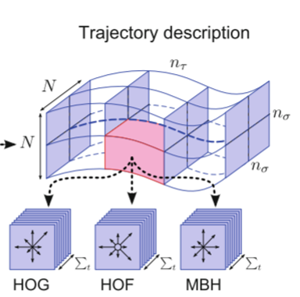
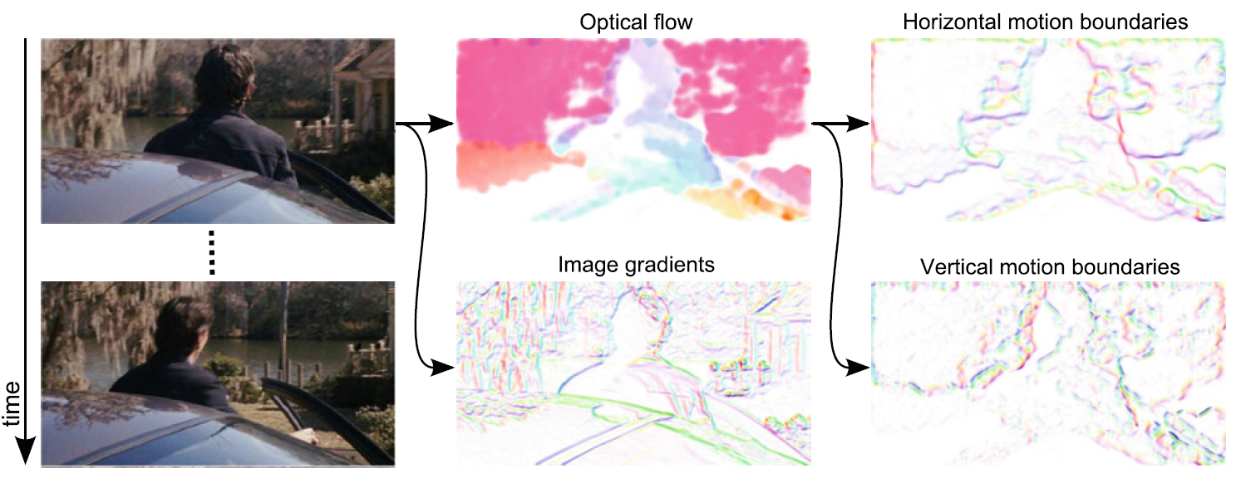

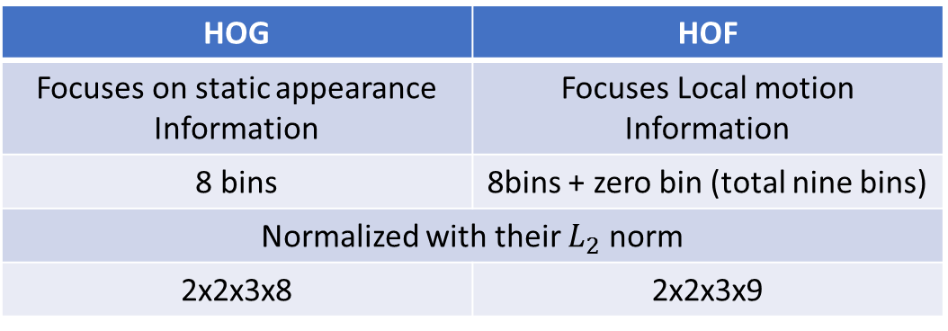
Dense trajectories and motion boundary descriptors
Dense
sampling
Motion and structure descriptors
N x N pixels and L frames long
Subdivided into a spatio-temporal gird of size
: $n_{σ} x n_{σ} x n_{τ}$ by HOG, HOF, MBH
Trajectories
HOG | HOF
Focuses on static appearance Information | Focuses Local motion Information
8 bins | 8bins + zero bin (total nine bins)
Normalized with their $L_{2}$ norm
2x2x3x8 | 2x2x3x9
Trajectory shape descriptor
Structure
Motion
Notes:
사람 배경화면 바운더리

Slide 24
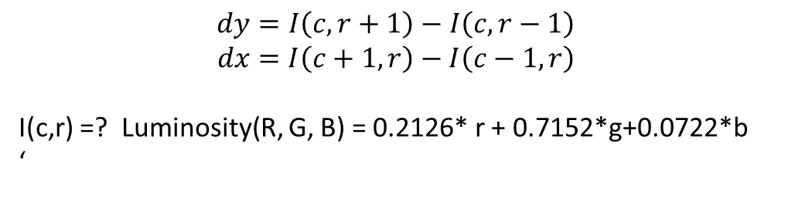
Dense trajectories and motion boundary descriptors
Dense
sampling
HOG steps
The image is first divided into small connected regions (cell)
I(C ,r+1)
I(C+1 ,r)
Trajectories
 | ·
C = X
Trajectory shape descriptor
 | ·
R = y
Structure
I(C-1 , r)
I(C ,r-1)
Motion
$$dy=I\left(c, r+1\right)−I\left(c,r−1\right)$$
$$dx=I\left(c+1, r\right)−I\left(c−1,r\right)$$
I(c,r) =? Luminosity(R, G, B) = 0.2126* r + 0.7152*g+0.0722*b
‘
Notes:
image

Slide 25
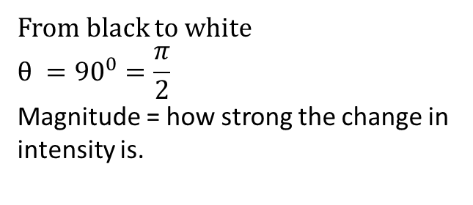
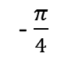
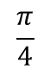
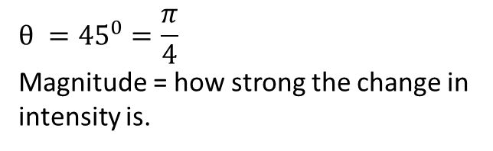
Dense trajectories and motion boundary descriptors
Dense
sampling
HOG steps
The image is first divided into small connected regions (cell)
Trajectories
 | ·
Gradient orientation
Gradient magnitude
Trajectory shape descriptor
From black to white
$$θ ={90}^{0}=\frac{π}{2}$$
Magnitude = how strong the change in intensity is.
Structure
$$\frac{π}{4}$$
Motion
$$θ ={45}^{0}=\frac{π}{4}$$
Magnitude = how strong the change in intensity is.
- $\frac{π}{4}$
Notes:
image

Slide 26
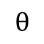
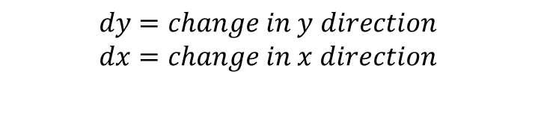
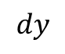
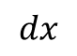
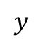
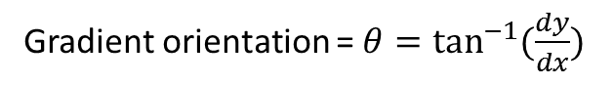


Dense trajectories and motion boundary descriptors
Dense
sampling
HOG steps
The image is first divided into small connected regions (cell)
$$x$$
Trajectories
 | ·
$$y$$
$$dy=change in y direction$$
$$dx=change in x direction$$
Trajectory shape descriptor
 | ·
$$dy$$
Structure
$$θ$$
·
$$dx$$
Gradient magnitude = $\sqrt{dy^{2}+dx^{2}}$
Motion
Gradient orientation = $θ=\tan^{−1}{(\frac{dy}{dx})}$
Notes:
image

Slide 27
Dense trajectories and motion boundary descriptors
Dense
sampling
HOG steps
The image is first divided into small connected regions (cell)
$$x$$
Trajectories
 | ·
$$y$$
$$dy=change in y direction$$
$$dx=change in x direction$$
Trajectory shape descriptor
 | ·
$$dy$$
Structure
$$θ$$
·
$$dx$$
Gradient magnitude = $\sqrt{dy^{2}+dx^{2}}$
Motion
Gradient orientation = $θ=\tan^{−1}{(\frac{dy}{dx})}$
Notes:
image

Slide 28










Dense trajectories and motion boundary descriptors
Dense
sampling
HOG steps
The image is first divided into small connected regions (cell)
For example, black - white
$$x$$
$$x$$
$$\tan^{−1}{(\frac{dy}{dx})}$$
Trajectories
 | ·
255 | 255 | 255
0 | · | 0
0 | 0 | 0
$$y$$
$$y$$
$$dy=255 −0=255$$
$dx=0 −0=0$ (no change)
$$dx=0 −0=1$$
Trajectory shape descriptor
Structure
$$θ ={90}^{0}$$
255
$\tan^{−1}{(\frac{255}{1})}⋅$ $\frac{180}{π}$
= $\frac{π}{2} ⋅\frac{180}{π}={90}^{0}$
 | ·
$$θ$$
Motion
$$1$$
Notes:
image

Slide 29





Dense trajectories and motion boundary descriptors
Dense
sampling
HOG steps
The image is first divided into small connected regions (cell)
For example, black - white
$$x$$
$$x$$
$$\tan^{−1}{(\frac{dy}{dx})}$$
Trajectories
 | ·
0 | 0 | 0
0 | · | 0
255 | 255 | 255
$$y$$
$$y$$
$$dy=0 −255=−255$$
$dx=0 −0=0$ (no change)
$dx=0 −0=1$ (positive constant)
Trajectory shape descriptor
$$1$$
Structure
$$θ$$
$\tan^{−1}{(\frac{−255}{1})}⋅$ $\frac{180}{π}$
= - $\frac{π}{2} ⋅\frac{180}{π}={−90}^{0}$
 | ·
- 255
$$θ ={−90}^{0}$$
Motion
Notes:
image

Slide 30


Dense trajectories and motion boundary descriptors
Dense
sampling
HOG, HOF and MBF descriptors
Trajectories
Trajectory shape descriptor
Structure
Motion
Notes:
image

Slide 31


Dense trajectories and motion boundary descriptors
Multi-channel approach(combined)
Notes:
Ac 평균 카이제곱 거리
비디오 x
설명기에 단어를 할당 4000개씩 데이터에 좋은 결과를 보여주는 그리고
K mean 클러스터링 으로
비선형 SVM RBF
Leave one out class 높은거 선택

Slide 32


Dense trajectories and motion boundary descriptors
Each descriptor: Trajectory, HOG, HOF, MBHx and MBHy
6 grid structures to represent a video
Results
Notes:
Bag of feature을 쌓는 구조
Dense 하면 피쳐 포인트가 추적이 가능하다
보케뷰러리중에서설명기에 가장 가까운 단어를 할당 유클리안 거리를 봐서 할당
비디오 마다 클래스가 있음

Slide 33


Dense trajectories and motion boundary descriptors
Dense trajectory for videos

Slide 34
Contents
Video
Dense trajectories and motion boundary descriptors
Spatio-Temporal ConvNet
Long-time Spatio – Temporal ConvNets

Slide 35

Spatio-Temporal ConvNets
Large-scale video
Single Frame
: Single flame baseline, that is only looking at a single frame of the video
Late Fusion
Take two alexNets
Place them same ten frames apart
Both compute independently in 10 frames apart
And then we emerged much later and fully connected layers
Karpathy, A., Toderici, G., Shetty, S., Leung, T., Sukthankar, R., & Fei-Fei, L. (2014). Large-scale video classification with convolutional neural networks. Paper presented at the Proceedings of the IEEE conference on Computer Vision and Pattern Recognition.
Notes:
색깔이 여러 개는 컨볼루션 노멀라이즈
풀링 레이어를 나타내고
슬로우 퓨젼은 파라미터들이 공유됨
C-N-P-C –FC –softmax
첫번째 풀리 레이어
클립클립

Slide 36
Spatio-Temporal ConvNets
Large-scale video
Early Fusion
The temporal information very early on the very first layer
Take chunk of frames
concatenate them along the channel 27x27x45
And then, everything stacked up
we do a single column over it
And then everything just to be ConvNets
Karpathy, A., Toderici, G., Shetty, S., Leung, T., Sukthankar, R., & Fei-Fei, L. (2014). Large-scale video classification with convolutional neural networks. Paper presented at the Proceedings of the IEEE conference on Computer Vision and Pattern Recognition.
Notes:
1) Your filters on the very first layer have a large temporal extent and then everything else is two-dimensional competition.
픽셀단위에서 퓨젼
로컬모션과 스피드
10 프레임을 4(시간축)개씩 각각 conv 값을 내 놓은 (stride 2)
2(시간축)로 다시 fusion

Slide 37
Spatio-Temporal ConvNets
Large-scale video
Slow fusion (3D Conv approach)
3 dimensional convolutions in both space and time
Slowly using this temporal information before slowly fusing the spatial information
But AlexNet is not enough to learning in video
Karpathy, A., Toderici, G., Shetty, S., Leung, T., Sukthankar, R., & Fei-Fei, L. (2014). Large-scale video classification with convolutional neural networks. Paper presented at the Proceedings of the IEEE conference on Computer Vision and Pattern Recognition.
Notes:
1) Your filters on the very first layer have a large temporal extent and then everything else is two-dimensional competition.
Average pooling

Slide 38
Spatio-Temporal ConvNets
How do we accelerate the learning?
Weight quantization schemes
Better optimization algorithms
Initialization strategies
Changes in the architecture that enable faster running times.
The size of the network – lower performance
Lower resolution
Improved the running time of the network
There exists a problem in high-frequency detail image

Slide 39

Spatio-Temporal ConvNets
Multiresolution architecture
Context streams : low-resolution image
Down sampled frame [178 x 178] ->[89 x 89] halved
Fovea streams : high-resolution center crop
Center [89x89] – fit in the online videos
Context streams
Fovea streams

Slide 40

Spatio-Temporal ConvNets
Filters learned on first layer of context steam and fovea stream
Left : context steam (low resolution)
Right : fovea stream (high resolution)

Slide 41

Spatio-Temporal ConvNets
Learned filters on the first layer
Visualize them and these are the kinds of features, learning on videos
These filters are also extended a small amount in time, so these little moving blobs
Karpathy, A., Toderici, G., Shetty, S., Leung, T., Sukthankar, R., & Fei-Fei, L. (2014). Large-scale video classification with convolutional neural networks. Paper presented at the Proceedings of the IEEE conference on Computer Vision and Pattern Recognition.

Slide 42
Spatio-Temporal ConvNets
Q. How much extent this in temporal length(t) for the filters we get to that? As possible as?
A. Yes, Just as in spatial, it works better if you have small filters, and you have more depth, the same applies
The prediction is a function saying fifteen frames: half a second video
Video frames and fixed number of categories at every single frame
not only a function single frame but also a small number or lots of frames
The significant problem of large scale videos is a lack of its data for Pre-Training
Notes:
Video frames and fixed number of categories at every single frame, it used to not only a function that single frame but also a small number or lots of frames.

Slide 43

Spatio-Temporal ConvNets
What we want is detect local motion from the point of view of prediction
In below table, there is small gain, 1.6 % point.
Just learn about single frame for the first
Karpathy, A., Toderici, G., Shetty, S., Leung, T., Sukthankar, R., & Fei-Fei, L. (2014). Large-scale video classification with convolutional neural networks. Paper presented at the Proceedings of the IEEE conference on Computer Vision and Pattern Recognition.
Notes:
1달동안
5개 클립 부터 20개 클립까지 반복적으로 수행 from 전체 프레임

Slide 44

Spatio-Temporal ConvNets
The below figure is to distinguish different sports
In tennis and swimming case,
We don’t need very fine local information for trying to distinguish tennis as fine-grained categories
But you have to think about small local motion in other case
Karpathy, A., Toderici, G., Shetty, S., Leung, T., Sukthankar, R., & Fei-Fei, L. (2014). Large-scale video classification with convolutional neural networks. Paper presented at the Proceedings of the IEEE conference on Computer Vision and Pattern Recognition.
Notes:
블루 참값
나머지는

Slide 45


Spatio-Temporal ConvNets
The comparison with ConvNet and 3D ConvNet.
image
Tran, D., Bourdev, L., Fergus, R., Torresani, L., & Paluri, M. (2015). Learning spatiotemporal features with 3d convolutional networks. Paper presented at the Proceedings of the IEEE International Conference on Computer Vision.
Notes:
Adding in time

Slide 46

Spatio-Temporal ConvNets
The comparison with ConvNet and 3D ConvNet.
image
Tran, D., Bourdev, L., Fergus, R., Torresani, L., & Paluri, M. (2015). Learning spatiotemporal features with 3d convolutional networks. Paper presented at the Proceedings of the IEEE International Conference on Computer Vision.
Notes:
Adding in time

Slide 47


Spatio-Temporal ConvNets
The comparison with ConvNet and 3D ConvNet.
Another volume
Tran, D., Bourdev, L., Fergus, R., Torresani, L., & Paluri, M. (2015). Learning spatiotemporal features with 3d convolutional networks. Paper presented at the Proceedings of the IEEE International Conference on Computer Vision.
Notes:
D is kernel temporal depth
K is kernel spatial size
3x3 필터가 짱
Depth? 2~4 but 첫번째 레이어의 depth 1 인 필터사용 초기에 정보손실을 최소화하기 위해

Slide 48

Spatio-Temporal ConvNets
The comparison with ConvNet and 3D ConvNet.
Experiment
Homogeneous temporal depth
Varying temporal depth
Tran, D., Bourdev, L., Fergus, R., Torresani, L., & Paluri, M. (2015). Learning spatiotemporal features with 3d convolutional networks. Paper presented at the Proceedings of the IEEE International Conference on Computer Vision.
Notes:
D is kernel temporal depth
K is kernel spatial size
3x3 필터가 짱
Depth? 2~4 but 첫번째 레이어의 depth 1 인 필터사용 초기에 정보손실을 최소화하기 위해

Slide 49


Spatio-Temporal ConvNets
Two(Image, optical flow)-stream version works much better than either alone.
We need hard coding for the optical flow than raw images because of not having enough data.
Simonyan, K., & Zisserman, A. (2014). Two-stream convolutional networks for action recognition in videos. Paper presented at the Advances in neural information processing systems.

Slide 50


Spatio-Temporal ConvNets
Optical flow ConvNets
(a),(b) are a pair of sequential video frames
Dense optical flow
(d): only horizontal component direction (L frames = depth)
(e): only vertical component direction (L frames = depth)
Notes:
L frames = depth
Sampled location and the motion

Slide 51

Spatio-Temporal ConvNets
Bi-directional optical flow
Mean flow subtraction
Camera movement
# of filters [7x7]
# of input channel over time
Notes:
C: 시간/공간을 내포하는 길이

Slide 52
Spatio-Temporal ConvNets
Spatial stream ConvNet
- 224x224 sub image cropped from random horizontal flipping and RGB jittering in the whole frame
Temporal stream
- 224x 224 x 2L (vertical, horizontal) Input cropped and flipped
Notes:
평균/SVM

Slide 53

Spatio-Temporal ConvNets
The outcomes of an experiment

Slide 54
Contents
Video
Dense trajectories and motion boundary descriptors
Spatio-Temporal ConvNet
Long-time Spatio – Temporal ConvNets

Slide 55

Long-time Spatio – Temporal ConvNets
All 3D ConvNets so far used local motion cues to get extra accuracy (e.g. half a second or so).
Half a second, it should be better classification.
Q. What if the temporal dependencies of interest are much more longer?
Q. How would you modify the architecture to actually model these kinds of much longer term event?
E.g. Several seconds?
A1. Attention model over different parts of the video to classify.
A2. Multi scale approaches where we process images on very low detail level (bottom) but also sometimes we resize the images and process them on global level(top).
We have a video that we would like to predict every single frame, RNN allows you to have infinite context in principle.

Slide 56

Long-time Spatio – Temporal ConvNets
3D Conv LSTM
The model detect little local motion from 3D ConvNet.
The model detect global motion from LSTM - have infinite context
= There is ability to take into account the information before and after using recurrent connections in the hidden layers
And then Put LSTM on fully connected layer
predicting classes from frames
Baccouche, M., Mamalet, F., Wolf, C., Garcia, C., & Baskurt, A. (2011). Sequential deep learning for human action recognition. Paper presented at the International Workshop on Human Behavior Understanding.

Slide 57

Long-time Spatio – Temporal ConvNets
We’d like to classify every single frame, The LSTMs string this together temporarily
Donahue, J., Anne Hendricks, L., Guadarrama, S., Rohrbach, M., Venugopalan, S., Saenko, K., & Darrell, T. (2015). Long-term recurrent convolutional networks for visual recognition and description. Paper presented at the Proceedings of the IEEE conference on computer vision and pattern recognition.

Slide 58


Long-time Spatio – Temporal ConvNets
LSTM that merged that over time, combination of local and global
Yue-Hei Ng, J., Hausknecht, M., Vijayanarasimhan, S., Vinyals, O., Monga, R., & Toderici, G. (2015). Beyond short snippets: Deep networks for video classification. Paper presented at the Proceedings of the IEEE conference on computer vision and pattern recognition.

Slide 59
Summary so far
We looked at two types of architectural patterns:
Model temporal motion locally (3D Conv)
Model temporal motion globally (LSTM/RNN)
Fusions of both approaches at the same time.

Slide 60
Long-time Spatio – Temporal ConvNets
RNN
(Optical flow)
Infinite (in theory)
temporal extent
(neurons that are function of all video frames in the past)
3D
Convnet
(Raw images)
Finite temporal extent
(neurons that are only a function of finitely video frames in the past)
Notes:
3x3 convet 2x2 maxpool and recurrent

Slide 61
Long-time Spatio – Temporal ConvNets
Infinite (in theory)
temporal extent
(neurons that are function of all video frames in the past)
RNN
(Optical flow)
3D
Convnet
(Raw images)
Notes:
Every single layer is recurrent Being infinite in extent as some parts finite

Slide 62
Long-time Spatio – Temporal ConvNets
Unsettling asymmetry
Neurons that are only a function of finitely video frames in the past.
Neurons that are function of all video frames in the past.
Q. How do we combine 3D ConvNet with RNN ?
A1. Doing RNN before convents are started (bad) : because it might be blurring images
A2. Work on multiple scales on that video and speed up the video and slow down video and then have 3D ConvNet, that’s on different temporal speed something like that (good)
A3. Do background subtraction*, and look at things are interesting to look (good)
A4. Have weight sharing between the 3d conv and RNN (bad)
RNN hidden state vector and you’re doing matrix multiplies and something like that , but in the convnet we have this like spatial structure
Get rid of RNN, we are going to basically take a convent, and we’re going to make every single neuron in that convent via small RNN

Slide 63

Long-time Spatio – Temporal ConvNets
With GRU is simpler version of the an LSTM, it works well
Stack-GRU-RCN
Intuitively, replaced with a Conv
Ballas, N., Yao, L., Pal, C., & Courville, A. (2015). Delving deeper into convolutional networks for learning video representations. arXiv preprint arXiv:1511.06432.

Slide 64

Long-time Spatio – Temporal ConvNets
Convolution Layer
It takes input from below the output of a previous Conv layer
And then Convs compute the output at that layer
Ballas, N., Yao, L., Pal, C., & Courville, A. (2015). Delving deeper into convolutional networks for learning video representations. arXiv preprint arXiv:1511.06432.

Slide 65
Long-time Spatio – Temporal ConvNets
GRU-RCN : Make every single convolutional layer a kind of a recurrent layer
Just as before we take the (current) input from below it (red) in this time step
And then Convs compute the output at that layer
But also take our previous output from the previous time step of conv layer (green)
We have activation from current input and have activation from previous output
Notes:
2-d convolutions there is no 3d conv

Slide 66

Long-time Spatio – Temporal ConvNets
The outcomes of an experiment

Slide 67
Summary
Think about motion, it is important for classification task
Local motion
Global motion
There is hint based on what you should try about
Compare single frame to your method
Using optical flow in second stream
GRU-RCN (best model so far)
Notes:
Just people like to kind of isolate these problems and tackle
In the business it was
Late approach : whatever works best videos and whatever works best audio and then emerge later somehow
Have a full connect later that’s looking at output of both, at some point and classifying as a function of both

Slide 68
Q & A

